Slide 1

LIFELINE
In the heart of a hospital, every heartbeat echoes the resilience of life and the compassion of healing hands.

Slide 2


Introduction
Who Are We?
"We are Lifeline, a dedicated team committed to revolutionizing healthcare through innovative technology solutions."
What We Do?
"We leverage cutting-edge technology to create Lifeline, a comprehensive healthcare platform that facilitates seamless communication, centralizes medical records, and predicts future healthcare needs, enhancing the efficiency and accessibility of healthcare services."

Slide 3
Objectives
Problem Statements and Solutions:
1) Medical Chatbot for Personal Health Guidance:
Problem: Dependency on elders for health guidance.
Solution: Introduce personalized medical chatbots providing instant guidance, explanations, and insights on health issues.
2) Centralized Database for Seamless Healthcare Continuity:
Problem: Lack of continuity in patient records when changing hospitals.
Solution: Create a centralized database connecting hospitals, patients, and doctors, ensuring seamless access to patient records across healthcare providers.

Slide 4
Objectives
Problem Statements and Solutions:
3) Automatic Medical Portfolio Generation:
Problem: Overreliance on paperwork for medical records. Solution: Implement an automatic medical portfolio system, reducing paperwork and providing a comprehensive digital record for patients.
4) Future Blood Availability Prediction:
Problem: Uncertainty in blood availability during emergencies. Solution: Develop a predictive analytics system to forecast future blood availability in different hospitals, optimizing blood management and emergency response.

Slide 5
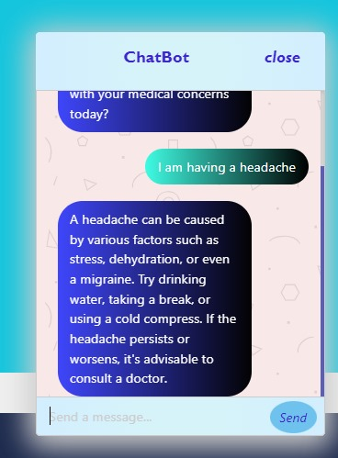

Slide 6
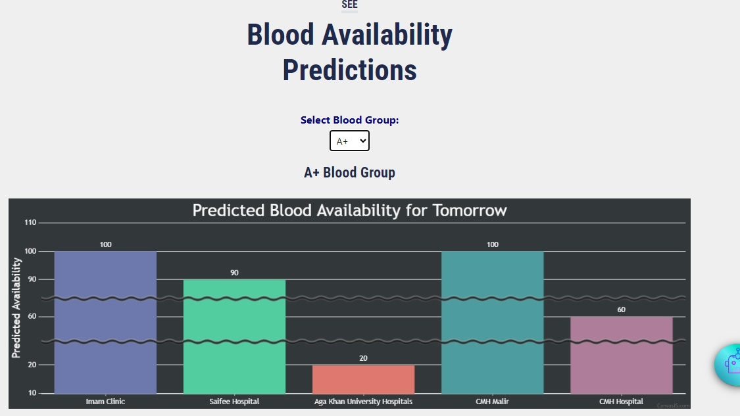

Slide 7
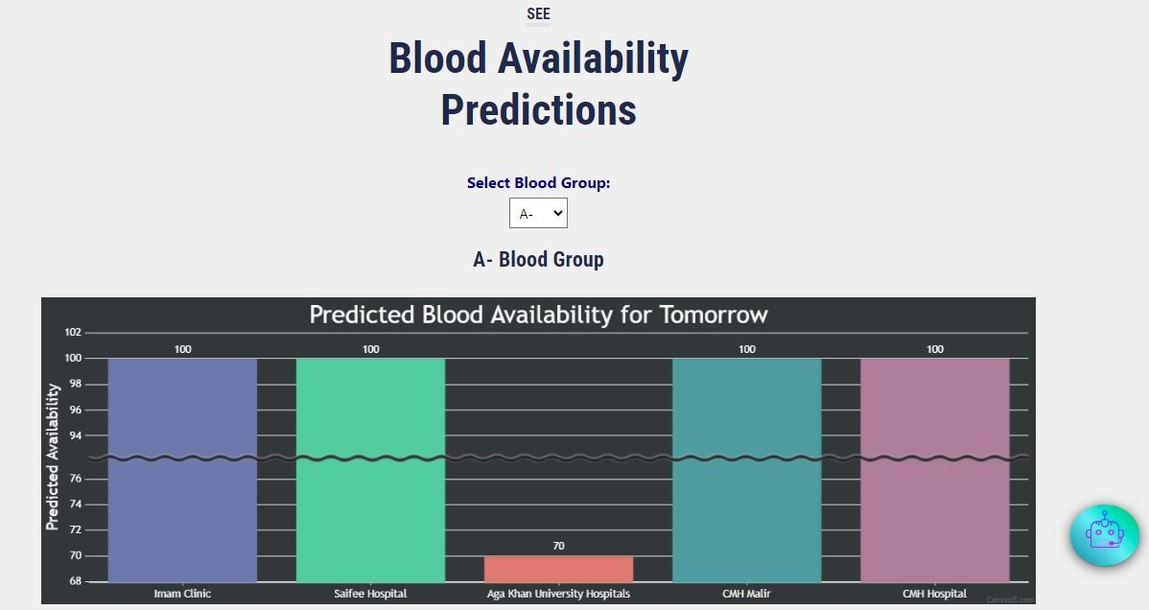

Slide 8
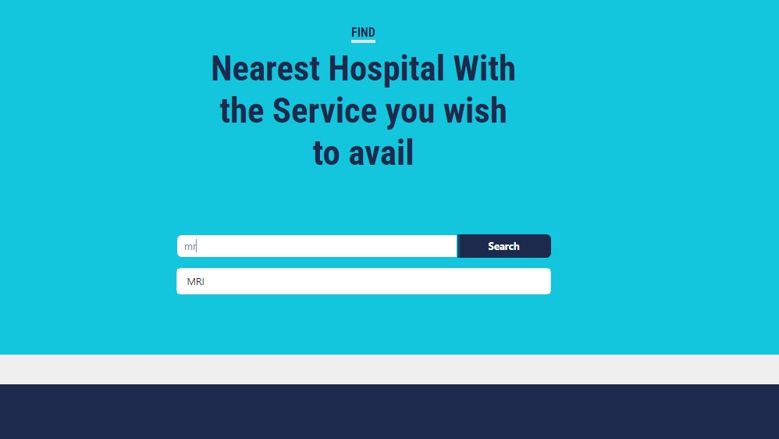

Slide 9
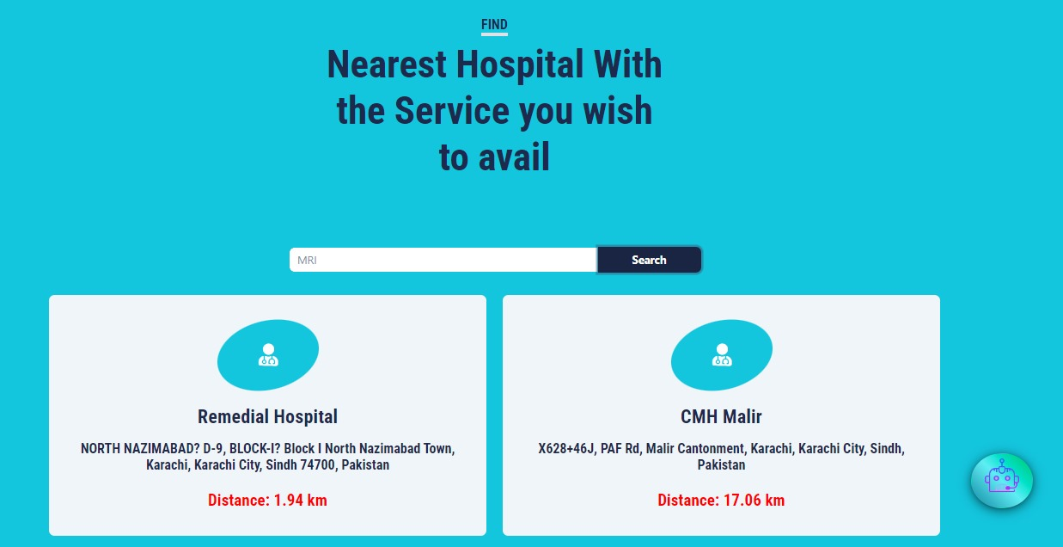

Slide 10

Project Features :
Doctor Dashboard:
Access patient records
Schedule appointments
Receive and manage medical queries
Patient Dashboard:
Access personal medical portfolio
Communicate with doctors
Receive health insights from the chatbot

Slide 11
Project Features :
Hospital Dashboard:
Manage patient records
Collaborate with other hospitals
Access predictive analytics for resource planning
Hospital Admin Dashboard:
Monitor hospital activities
Ensure data security and compliance
Facilitate seamless communication between departments

Slide 12


Conclusion:
Lifeline aims to transform the healthcare landscape by providing a unified platform for efficient communication, streamlined data management, and predictive analytics. With its user-friendly dashboards and innovative features, Lifeline is poised to revolutionize healthcare delivery, ensuring a healthier and connected world.

Slide 13

Future Plans?

